Slide 1
Recent Tax Changes and Impact on Flow-Through Share Deal Metrics
Ron Bernbaum

Slide 2
DISCLAIMER
This information is current to October 16, 2024 unless otherwise indicated. The information contained herein is of a general nature and is not intended to address the circumstances of any particular individual or entity. Although we endeavor to provide accurate and timely information, there can be no guarantee that such information is accurate as of the date it is received or that it will continue to be accurate in the future. No one should act on such information without appropriate professional advice after a thorough examination of the particular situation.
Red Cloud Mining Showcase
Ron Bernbaum
PearTree Canada
2

Slide 3
PEARTREE CANADA: WHO WE ARE
Founded in 2007
Unique Platform serving the mining and charity sectors
> $500 Million in FTS Financings Annually in > 60 closings per year
Structure reduces dilution while enabling global investment at reduced cost of investor capital
5,000+ charities supported across Canada adds to ESG issuer profile
Red Cloud Mining Showcase
Ron Bernbaum
PearTree Canada
3

Slide 4
WHAT ARE WE GOING TO TALK ABOUT?
What the Flow-Through market really looks like
Legislative Uncertainty
Impact of AMT and capital gains tax increase
Red Cloud Mining Showcase
Ron Bernbaum
PearTree Canada
4

Slide 5
CANADIAN EQUITY FINANCING FOR EXPLORATION IN CANADA
Over 80% of financings for mineral exploration on Canada exchanges are via FTS
Red Cloud Mining Showcase
Ron Bernbaum
PearTree Canada
5
Sources: S&P Global Market Intelligence, TMX Group and PDAC analysis

Slide 6
CANADIAN FLOW-THROUGH FINANCINGS
Red Cloud Mining Showcase
Ron Bernbaum
PearTree Canada
6
Sources: PDAC Analysis and Laurentian Bank Securities

Slide 7
WHO’S BUYING FLOW-THROUGH IN 2021?
In 2021, 88% ($1.06B) of all FT funding was provided by 14,400 taxpayers earning $250,000 or more, an average of $74,000 per subscriber
PearTree clients purchase ~$500M annually and average $239,000, that’s ~2,100 people providing 44% FT funding in Canada.
The remaining 12,300 high-earning taxpayers purchase an average of $45k annually.
Total FT Purchased
$1.2B
Sources: Stats Canada
Red Cloud Mining Showcase
Ron Bernbaum
PearTree Canada
7

Slide 8
Living in a time of legislative uncertainty
Red Cloud Mining Showcase
Ron Bernbaum
PearTree Canada
8

Slide 9
AMT
What does it mean for Exploration
Red Cloud Mining Showcase
Ron Bernbaum
PearTree Canada
9

Slide 10
WHAT IS ALTERNATIVE MINIMUM TAX – AMT?
AMT is a parallel tax calculation that applies to high income earning taxpayers who could otherwise pay little to no tax due to various deductions and credits.
Taxpayers are required to pay the higher of either their regular tax minus deductions and credits, or the AMT.
Red Cloud Mining Showcase
Ron Bernbaum
PearTree Canada
10

Slide 11
FLOW-THROUGH IN 2024?
All 14,400 taxpayers are going to be affected by AMT, and will only be able to purchase 2/3 of their previous amount
$1.06B becomes $707M + $140M (the 12%)
$1.2B in exploration spend IN 2021 would have been $847M with AMT, a loss of $350M
Total FT Purchase
$847M
Red Cloud Mining Showcase
Ron Bernbaum
PearTree Canada
11

Slide 12
AMT - IMPACT ON THE CRITICAL MINERALS TAX CREDIT (CMETC)
Over $500M raised by just ~1,200 people for Critical Mineral Exploration under the CMETC in the first 18 months of implementation.
These 1,200 people are all impacted by AMT. They will all subscribe up to their AMT limit, which will be reduced by 1/3.
By extension, if the new AMT rules had been in place, only $333M would have been raised.
Sources: PearTree Canada
Red Cloud Mining Showcase
Ron Bernbaum
PearTree Canada
12

Slide 13
AMT POLICY – WHAT’S CHANGING
AMT changes related to flow-through
Increase capital gain inclusion rate from 80% to 100%
Increase capital gains realized on donation of securities from 0% to 30%
Disallow 50% of many deductions and credits, including charitable tax credits
Red Cloud Mining Showcase
Ron Bernbaum
PearTree Canada
13

Slide 14
FLOW-THROUGH SUBSCRIPTIONS BY CCPCS
CEE and CDE
Delta 2023 – 1.40
Delta 2024 post capital gains increase – 1.15
Red Cloud Mining Showcase
Ron Bernbaum
PearTree Canada
14

Slide 15
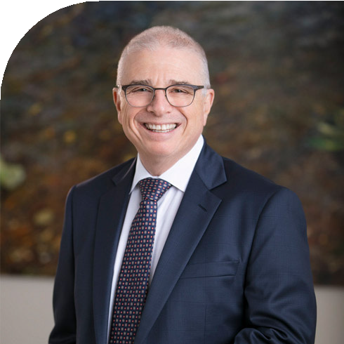
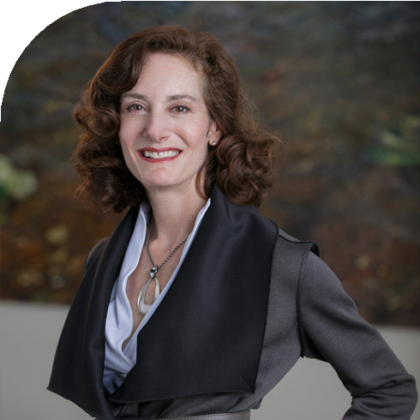
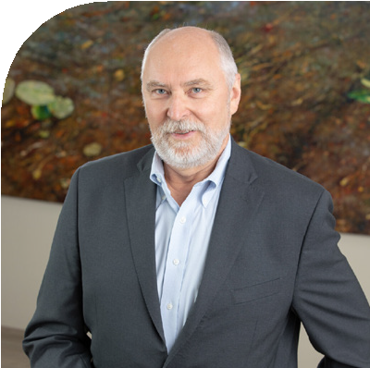
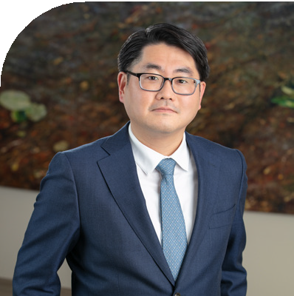
OUR TEAM
OUR TEAM
Ron Bernbaum, LL.B
Founder
+1.416.322.2288
ron.bernbaum@peatreecanada.com
Lisa Davis, LL.B, ICD.D
CEO
+1.416.322.2299
lisa.davis@peatreecanada.com
Gary J. Baschuk, B.Sc.,
Co-head, Mining & Senior Geologist
+1.416.322.2297
gary.baschuk@peatreecanada.com
Ricky Chan, CPA, CA, CFA
Co-head, Mining
+1.416.322.2298
ricky.chan@peatreecanada.com
Kendra Johnston, PGeo, MBA
Managing Director
+1.416.322.2295
kendra.johnston@peatreecanada.com
Danny Mah, CFA
Head, Energy
+1.647.498.6240
danny.mah@peatreecanada.com
Jessica Stern, LL.B
General Counsel
+1.416.322.2290
jessica.stern@peatreecanada.com
Sean Kim
Senior Associate, Legal Counsel
+1.416.322.2296
sean.kim@peatreecanada.com
peartreecanada.com

